Slide 1
Network Security
Spring 2025
CS 6823 - Lecture 0
Introduction, Expectations, and Policies
Phillip Mak
pmak@nyu.edu

Slide 2
Who am I?
Phillip Mak
Cybersecurity Officer at a major international organization
Formally Security Operations Center Lead at a large government agency
Formally 12 years career as Cybersecurity Lead at the Department of Defense
Network Communications Intern at N.Y.S.E
Provide systems and security engineering services to Army programs during the development lifecycle
Cybersecurity monitoring during live operational testing of networked system
Cybersecurity protections for DoD systems

Slide 3
Course Organization

Slide 4
WARNING You will be learning potentially dangerous techniques in this course. By continuing the beyond this point you agree that all of the knowledge gained will be used in an ethical manner. The point of this course is to learn about network security not to harm people or systems. If you do, you will end up in jail and I won’t be able to (or will) save you.

Slide 5
Contact Information
The best way to reach me by email:
pmak@nyu.edu
Office hours: By appointment on Slack
Send me a message with your availability
Let me know if you prefer voice or video
Feel free to make an appointment for general discussions.
Slack
You can also send me a message anytime on Slack, but that’s more informal.
Please do email me any suggestions, questions, topics, or interesting tidbits or articles you may have, which I will try go over them at the next class. This allows me to talk about topics that you have an interest with.

Slide 6
Course Website
https://brightspace.nyu.edu/d2l/home/444512
Assignments are located on Gradescope
An account has been created for you
Syllabus - subject to change so check the NYU Classes “Syllabus”
Lecture Slides - will be posted prior to class. Students must review the slides before the corresponding lecture
Assigned Readings are typically news and research articles related to current events in Cybersecurity

Slide 7
SEED Labs
Allows usage and practice of security tools in a controlled environment on your own computer.
We are using version SEED 2.0: Ubuntu 20.04 VM (64-bit)
SEED website: https://seedsecuritylabs.org/labsetup.html
Virtual Box (Windows & non-Apple Silicon Macs):
Download SEED-Ubuntu20.04.zip
VM Manual: follow this manual to install the VM on your computer
VMWare Fusion (Apple Silicon Macs (M-series Macs))
For Apple Silicon Macs, follow the instructions here: https://github.com/seed-labs/seed-labs/tree/master/lab-setup/apple-arm#building-the-seed-vm-on-fusion
Cloud Version:
Alternatively, you can use the cloud version. I recommend DigitalOcean. It's a guaranteed $12/month -- no overages -- so it'll be $48 for the semester. Currently, there is a promotion of $100 credit via the GitHub Student Developers program if you sign up using your NYU email address: https://www.digitalocean.com/github-students/
Instructions: https://github.com/seed-labs/seed-labs/blob/master/manuals/cloud/seedvm-cloud.md
Tip: You will need a US IP address when signing up. Use the NYU VPN. You already have an account, just follow the instructions to download the client and sign in.
Tip 2: Some students had better performance with the $24/mo plan, but it's not required.
If this is your only option, and you do not have the financial means for the subscription, you may apply to the NYU Student Emergency Fund for cases when students face unexpected emergencies that have impacted their financial situation.

Slide 8
Course Goals
Understand the problems of securing a network
Understand the underlying protocols and technologies
Crypto, IPsec, TLS
Examine the methods and tools for attacking and defending a network
network reconnaissance, enumeration, exploits, tools.
defense tools (firewalls, ids, router, switches, wireless)
Explore some advanced topics
E.g., Firewalls, Wireless
Notes:
Purpose: Security concepts, not specific technologies
Next several classes: All the steps that a hacker needs to break into a system:
Gathering information – what IP addresses are owned, topology
Identifying hosts and services
Finding vulnerabilities
Exploitation: gaining access, elevating access
Post-Exploitation: maintaining access, removing traces
Cryptography: how encryption works, how SSL works
Network Defense Tools
IPv6

Slide 9
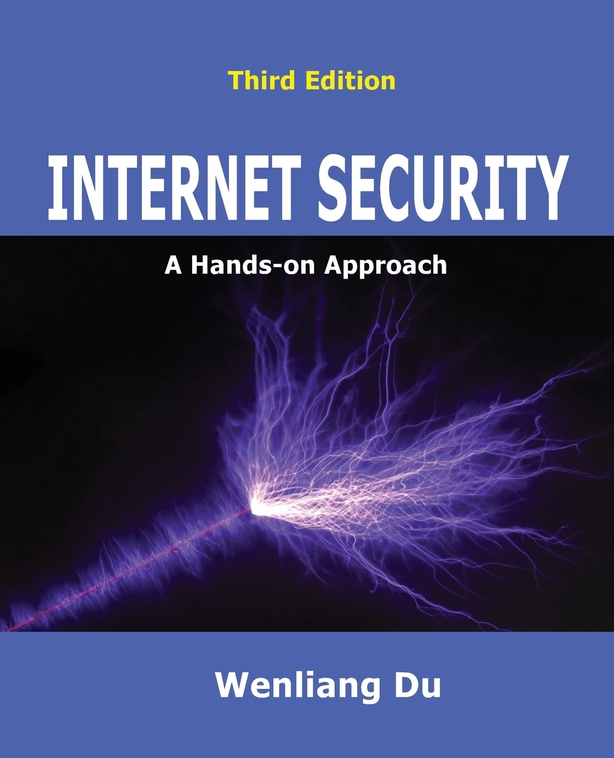
Textbook
Internet Security: A Hands-on Approach
Wenliang Du
ISBN: 978-1733003964
Published: 2022
Amazon link
Reading materials (such as URLs, papers, news articles) will be regularly assigned and posted on NYU Classes. These materials may be on the exam.
Notes:
Books not required, but it helps a lot to get you into the mindset of fundamentals

Slide 10
Prerequisites
Good Foundation in Networking and TCP/IP. CS 684 or equivalent course in computer networking.
Reference: Internetworking with TCP/IP, Vol 1, 5th Edition, Doug Comer
Basic understanding of operating systems with a working knowledge of Linux.
Notes:
TCP/IP: understanding the OSI model
ARP vs. IP
Ethernet, IP, TCP packet
Linux – Lab 1
Course difficulty – Computer Security
- make clear what the prerequisits
- don't have it, they should drop the class
- NYU only has one week to add/drop. next monday
- 3.4 is the average grade

Slide 11
Course Policies
10% Homework & Quizzes
40% Labs
25% Midterm
25% Final
2% Weekly Bonus
Bonus points given for optional weekly exercises
Labs & Homeworks have a varying due date. Extra percentage points for submitting early and deducted for lateness.
Exceptions
Family/Personal/Medical – Excused Absence Form
Work emergency: Speak to Prof. Mak
Academic Dishonesty/Plagiarism policy – Don’t do it
https://www.nyu.edu/about/policies-guidelines-compliance/policies-and-guidelines/academic-integrity-for-students-at-nyu.html
Notes:
How to get an A
change of grades are not allowed
Plagiarism in academics vs. legal
No tolerance

Slide 12
Usage of Generative AI
Welcomed to use generative AI tools (e.g. ChatGPT, etc.) for idea generation only in labs and assignments.
Not allowed for exams
You are responsible for the information submitted
for instance: that it does not violate intellectual property laws, or contain misinformation or unethical content
No personal information
must be properly documented and cited in each case
E.g. quote + [paragraph from ChatGPT]
Must not violate NYU’s Academic Integrity Policy, which forbids “submitting work (papers, homework assignments, computer programs, experimental results, artwork, etc.) that was created by another, substantially or in whole, as one's own.”
Notes:
How to get an A
change of grades are not allowed
Plagiarism in academics vs. legal
No tolerance

Slide 13
Weekly Exercises – Bonus (Optional)
During lecture each week, there are optional exercises during the lecture
Submit responses in the “Week X Exercises” assignments
Weekly Exercises are due 2 hours prior to the next class
Total bonus would be an additional 2 percentage points added to the top of the final course grade

Slide 14
Course Expectations
Learning Time Element | Asynchronous* / Synchronous** | Time on Task for Students (weekly) | Notes
Lecture | Asynchronous | 2 - 3 hours | Attending live lecture or view recordings. Although asynchronous, must be performed within a week.
Research | Asynchronous | 3 | Learners review background materials to understand concepts discussed in the lecture slides.
Readings | Asynchronous | 1 | Learners complete recommended readings (online journal articles and tutorials).
Lab Assignments | Asynchronous | 6 | Learners independently complete lab assignments using the SEED Virtual Machines, which can include scapy coding and troubleshooting programs, setting up networks, sniffing traffic, and writing firewall rules.
Homeworks | Asynchronous | 1 | Learners independently complete homework assignments, which typically consists of multiple choice, short answers, and Immersive Labs activities.

Slide 15
Prepping for Class
Join Slack
Provide a quick intro to include
Info about yourself, e.g., major, expected graduation
Any prior Cyber experience or Cyber classes
Any particular topic you’re interested in
An interesting fact about yourself
Using Slack is a required part of the class – announcements, details, and discussions are a part of the class
Subscribe to the calendar feed on your mobile device
Brightspace -> Calendar -> Subscribe
Set up SEED Labs

Slide 16
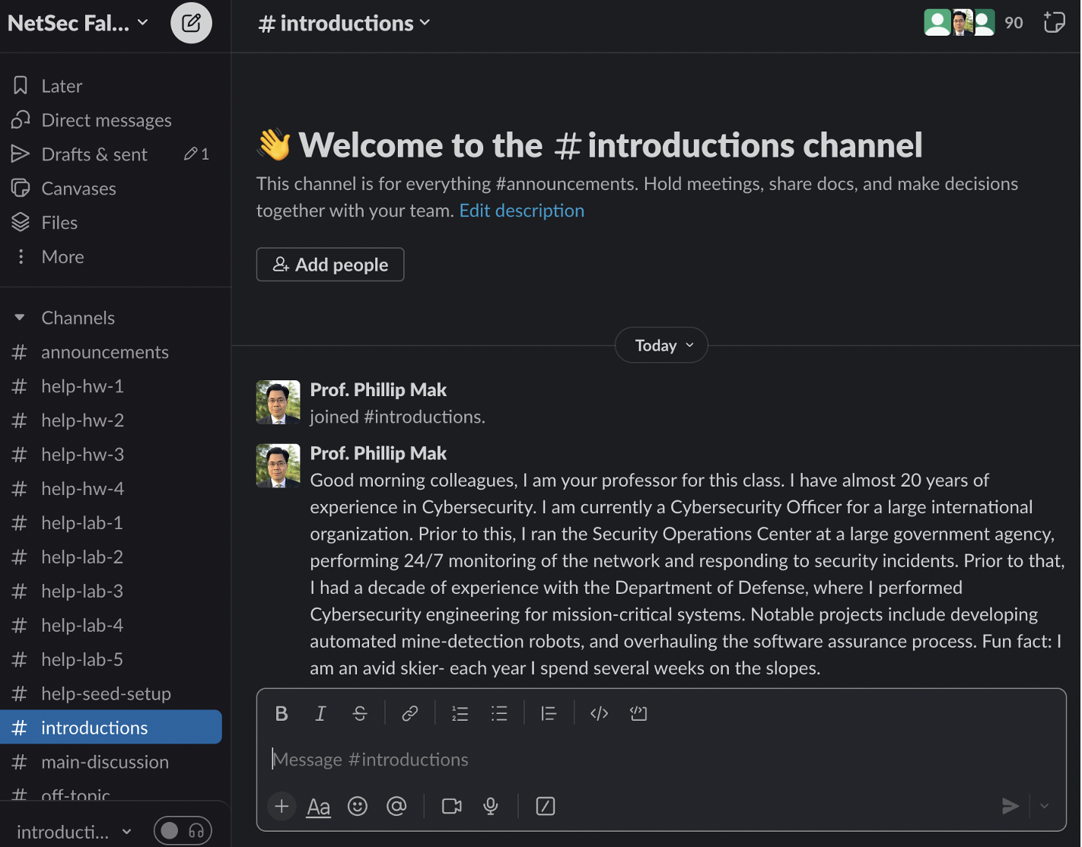
Slack
You will receive an invite to the Slack workspace
Please introduce yourself in the #introductions channel
Usage of Slack is required for this class

Slide 17
Things That I Won’t Do at the End of the Course
Give you extra work so that you can try and improve your grade
Bump your grade up because you feel that you deserve it, need it for a scholarship, etc.
Review earlier assignments in an effort to try and “find’ points.
Unless there is a true grading error, do not come asking for extra points.

Slide 18
Syllabus
*Class Schedule Live Class 4-6 PM ET
Week | Date | Lesson | Readings (from Internet Security: A Hands-on Approach. 3rd Edition)
1 | Mon, 27 Jan | Lesson 0: Introduction, Expectations, and Policies Lesson 1: Security Basics What is Network Security, Thinking Differently and the Larger System in Play Risk Management Qualitative Risk Assessment | Ch 1: Network Security Basics, 1.2-1.6 Ch 6: Attacks on the TCP Protocol
2 | Mon, 3 Feb | Lesson 2: Network Recon – Part I The Cyber Kill Chain Performing OSINT Network Scanning and Enumeration: whois, DNS, traceroute, host discovery DNS Reconnaissance Port and Service Discovery
3 | Mon, 10 Feb | Lesson 2: Network Recon – Part II
 | Mon, 17 Feb | NO CLASS -- Presidents' Day
4 | Tue, 18 Feb | Lesson 3: Vulnerabilities and Exploits – Part I Vulnerability Identification Spoofing Session Hijacking DOS/DDOS Attacks DNS Attacks Metasploit | Ch 3. The Internet Protocol (IP) and Attacks
5 | Mon, 24 Feb | Lesson 3: Vulnerabilities and Exploits – Part II | Ch 10. DNS and DNS Attacks, 10.1, 10.2, 10.5-10.11
6 | Mon, 3 Mar | Lesson 4: Post-Exploitation Persistence Data Exfiltration Removing Evidence | Ch 14. Reverse Shell
 |  | This lesson will be asynchronous only Lesson 5: Cryptography Cryptography Basics: Caesar’s Cipher, Substitution Cipher, Vigenère Symmetric Key Cryptography Block Ciphers Mode of Operations Public Key Cryptography: RSA, DH | Ch 15. Secret-Key Encryption, 15.1-15.5
7 | Mon, 10 Mar | Midterm Review
 | Sat, 15 Mar | Midterm on Lesson 1-5 Only Starting time: 10 AM - 12 NOON ET

Slide 19
Syllabus
*Class Schedule Live Class 4-6 PM ET
Week | Date | Lesson | Readings (from Internet Security: A Hands-on Approach. 3rd Edition)
8 | Mon, 17 Mar | Lesson 6: Message Integrity, Public Key Infrastructure, and TLS – Part I Message Integrity Protection Diffie-Hellman Exchanges Message Integrity: hashing, nonce Securely Sending Messages | Ch 4. Packet Sniffing and Spoofing, 4.3.5, 4.4, 4.5 Ch 16. One-Way Hash Function, 16.1-16.5
 | Mon 24 Mar | NO CLASS -- Spring Break
9 | Mon, 31 Mar | Lesson 6: Message Integrity, Public Key Infrastructure, and TLS – Part II Public Key Infrastructure Digital Signatures Certificate Authorities, X509v3 Certificates Certificate Issuance and Validation | Ch 18. Public Key Infrastructure
10 | Mon, 7 Apr | Lesson 6: Message Integrity, Public Key Infrastructure, and TLS – Part III Transport Layer Security TLS Ciphersuites Types of TLS Certiticates: DV, OV, and EV TLS Full Handshake Perfect Forward Secrecy TLS Protocol in Detail | Ch 19. Transport Layer Security (TLS)
11 | Mon, 14 Apr | No Live Class - This lesson will be asynchronous only Lesson 7: Firewalls Basic filtering rules Proxies and Gateways Tunneling Protocols Iptables | Ch 7. Firewall
12 | Mon, 21 Apr | Lesson 8: Layer 2 Security ARP Attacks VLAN Attacks DHCP Attacks Spoofing Spanning Tree Protocol | Ch 2. The MAC Layer and Attacks
13 | Mon, 28 Apr | Lesson 9: Wireless Security IEEE 802.11 Overview Wireless Authentication and Association 802.1x Wi-Fi Security Protocols: WEP/WPA/WPA2/WPA3
14 | Mon, 5 May | Final Review
 | Sat, 10 May | Final on Lesson 6 Onward Only Starting time: 10 AM - 12 NOON ET

Slide 20



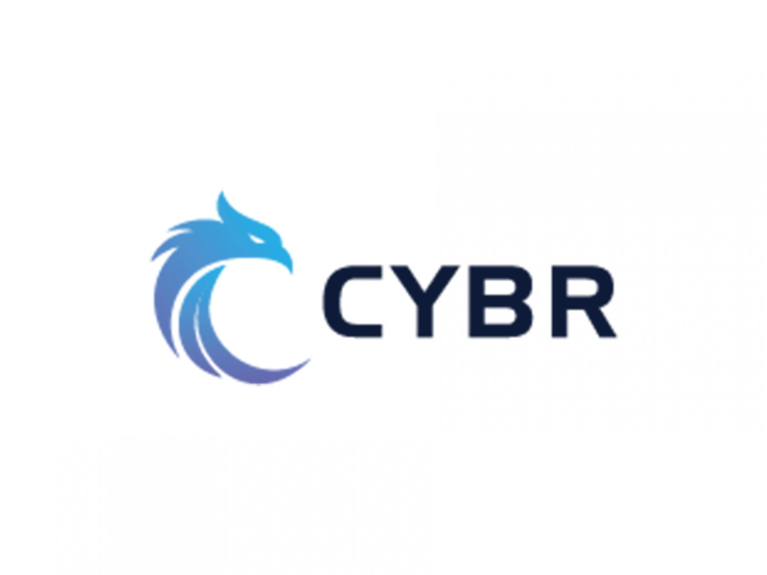
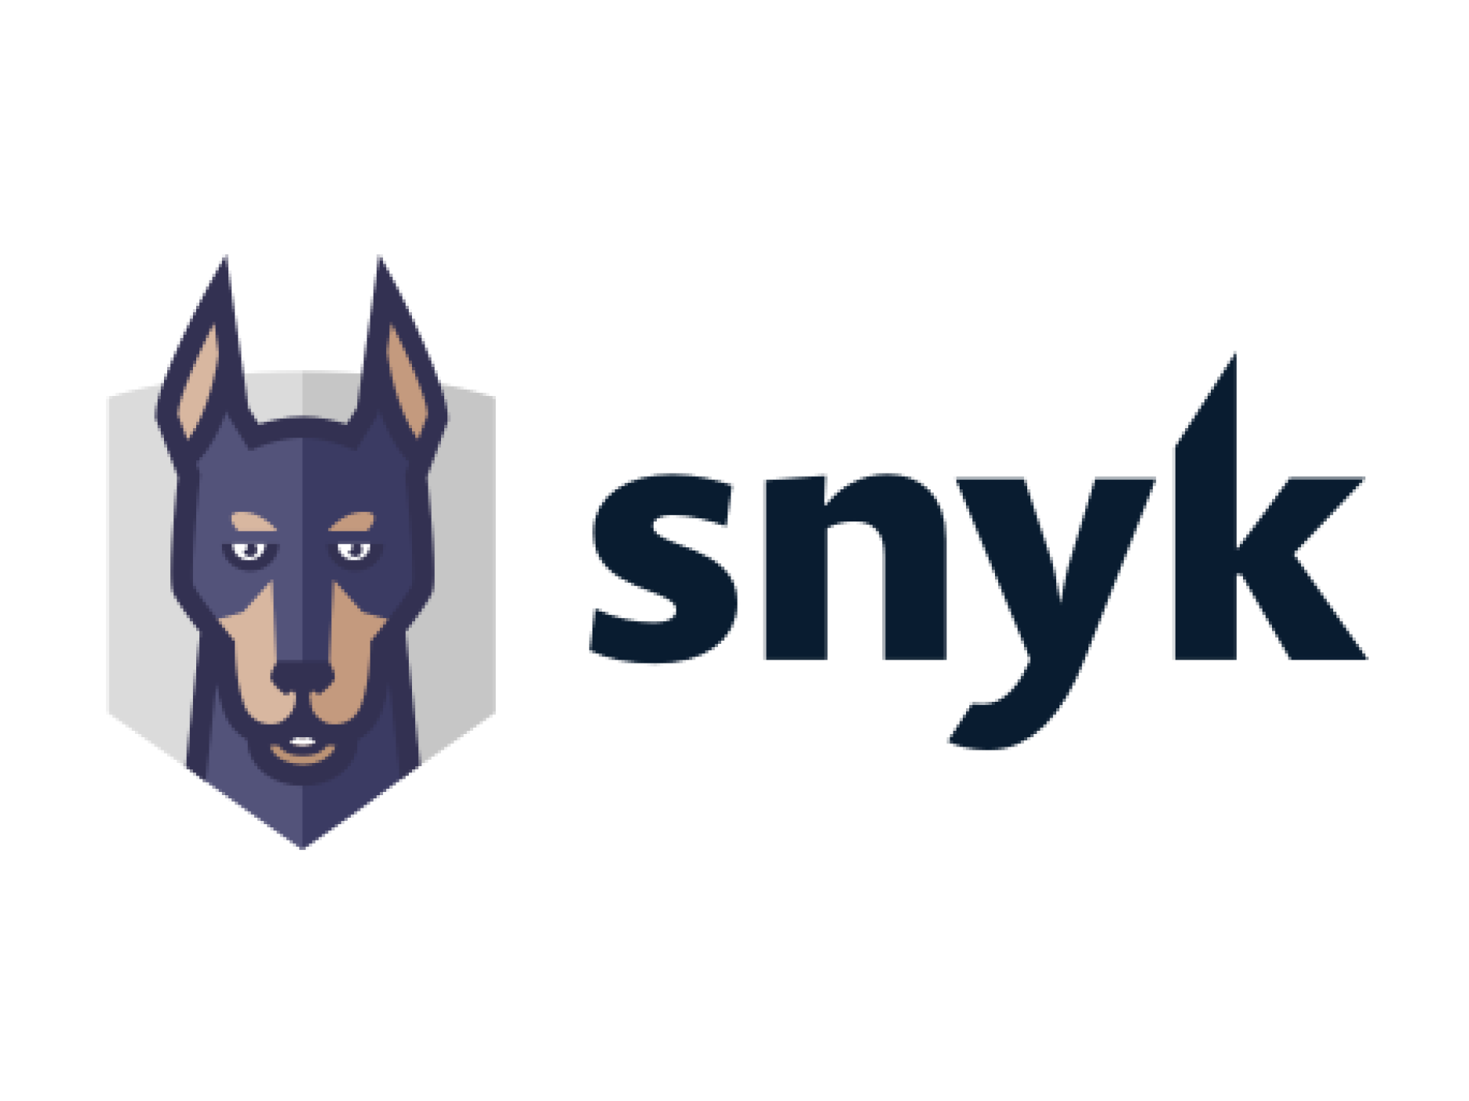




NYU Tandon Cybersecurity Industry Partner Badges
NYU Tandon Cybersecurity Industry Partner Badges

